Slide 1
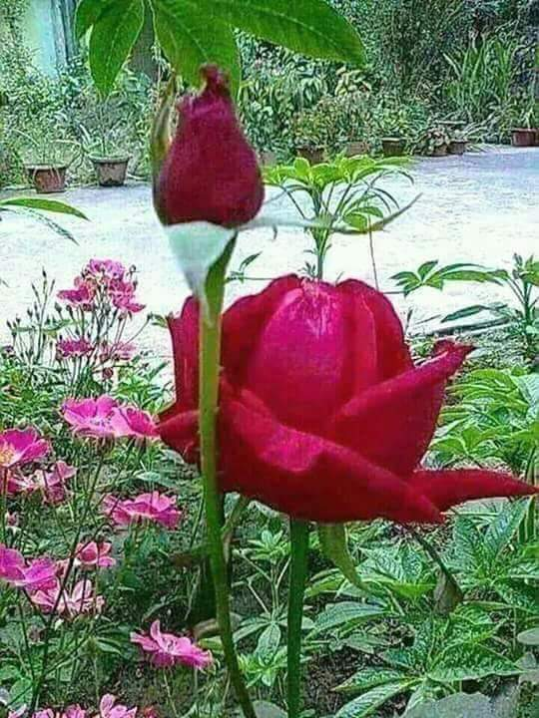
Welcome

Slide 2
Introduce of teacher
Mita Das
Assistant teacher
Chandrapara govt. primary school
Kachua, Bagerhat.

Slide 3
Introduce of the lesson
Class:2
Subject:English
Unit:25
Lesson:1-3
Part of the lesson:A,B,C
Time:40 minitus
Date:20/03/2018

Slide 4
Learning outcome
Listening : 1.1.1 become familiar with English sounds by listening to common English words.
Speaking : 1.1.1 repeat after the teacher simple words and phrases with proper sounds and
Reading : 1.4.1 read words and phrases with the help of visual clues (about 30 new words) and simple sentences.

Slide 5
Lets sing a song

Slide 6
Lesson diclaration
Life everyday

Slide 7
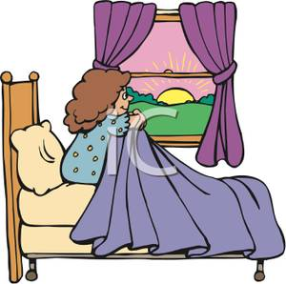
Get up

Slide 8
Wash my face

Slide 9
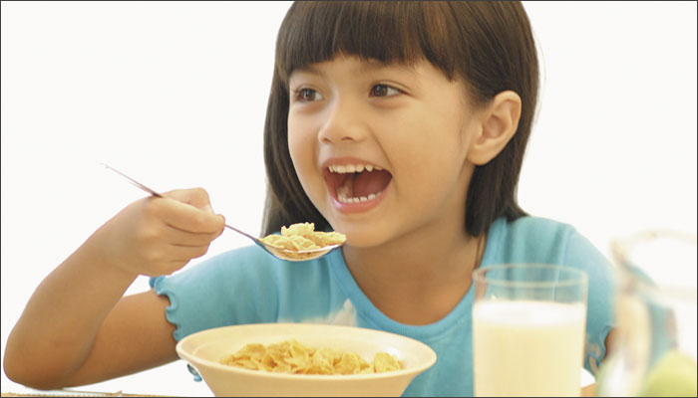
Have breakfast

Slide 10
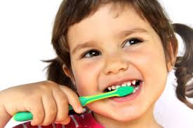
Brush my teeth

Slide 11
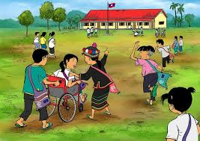
Go to school

Slide 12
Find out new words
Get up
Breakfast
Wash
Brush

Slide 13
Open page at 50

Slide 14
Teacher’s reading

Slide 15
SS reading with teacher

Slide 16
SS reading practice

Slide 17
Get up
Wash
Breakfast
Brush
Go to school
Morning
activities

Slide 18
Role play

Slide 19
Bingo game

Slide 20
IW
Ask and answer
1.When do you get up?
2.What do you like to eat breakfast?
3.When you go to school?

Slide 21
Pair work
Say two morning activities

Slide 22
Group work
Group 1.Say the name of 5 activities whice you do in every morning?
Group 2.Say the name of 5 activities whice you did last morning?

Slide 23
Home work
Make a list what do you do at night.

Slide 24
Thanks

